Slide 1
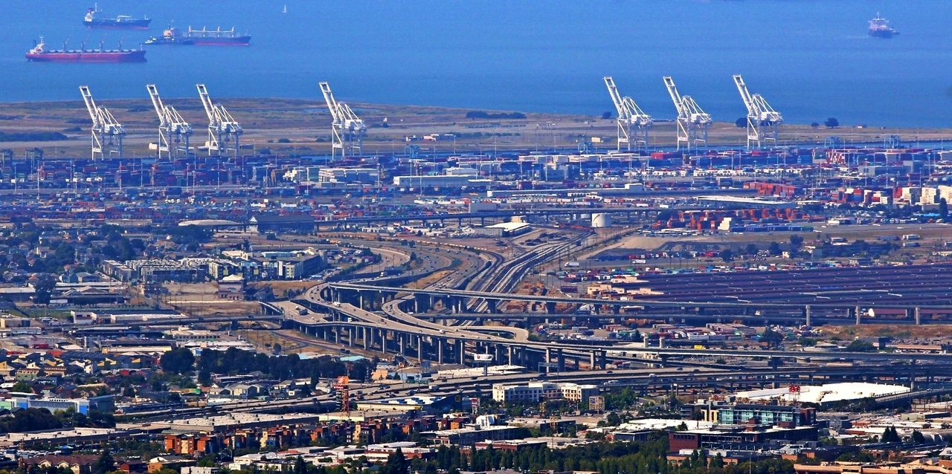
Data Science for Transportation
12 Jan 2017
Dr. Greg Erhardt
261 OHR 859-699-1761 greg.erhardt@uky.edu

Slide 2
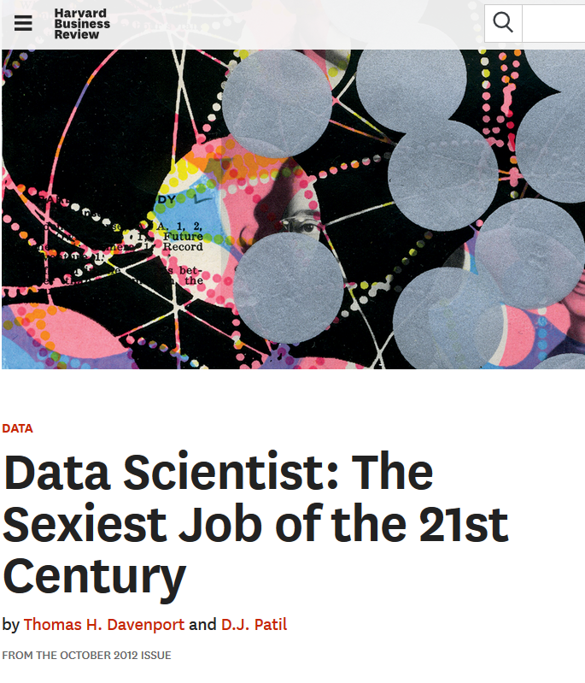
Why Data Science?

Slide 3
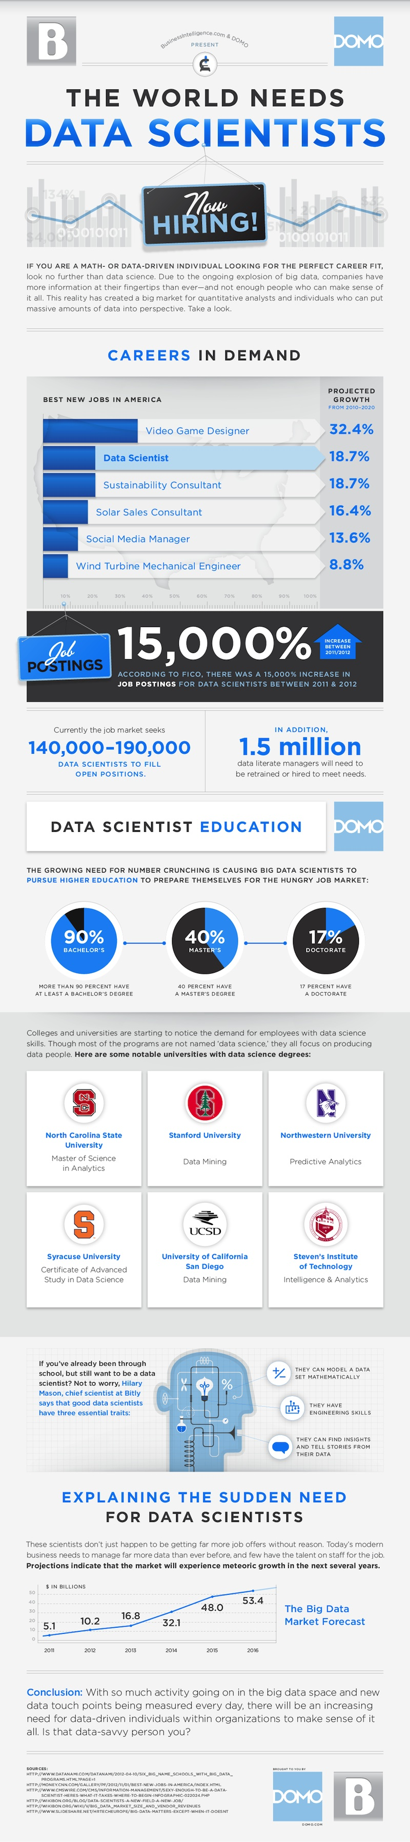
Why Data Science?
http://venturebeat.com/2013/11/11/data-scientists-needed/

Slide 4
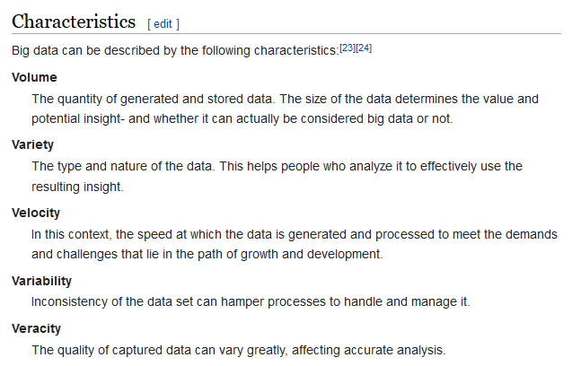
What is Big Data?

Slide 5
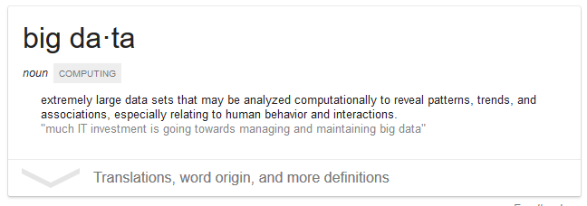
What is Big Data?

Slide 6
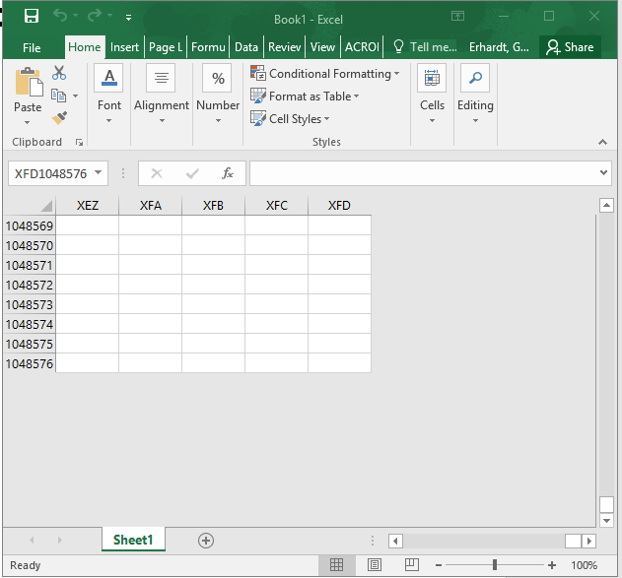
What is Big Data?
Anything that doesn’t fit in an Excel spreadsheet

Slide 7
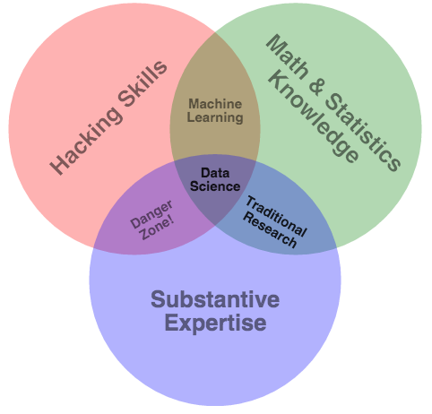
What is Data Science?
http://drewconway.com/zia/2013/3/26/the-data-science-venn-diagram.

Slide 9
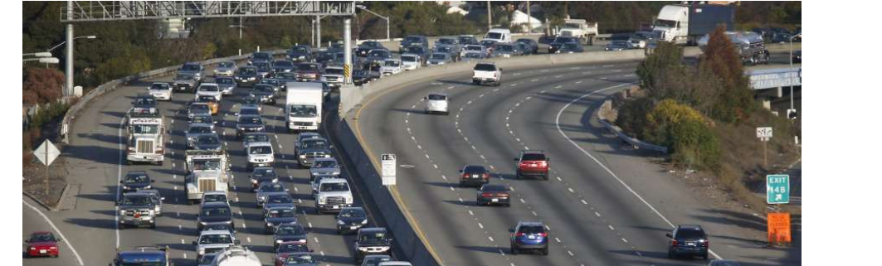
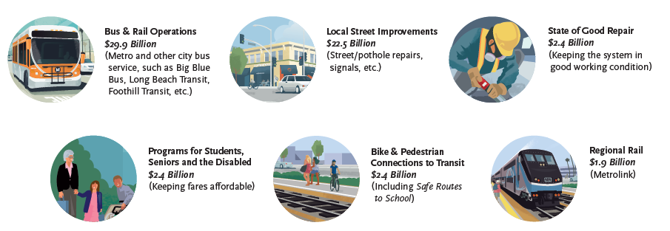
Why Transportation?

Slide 10
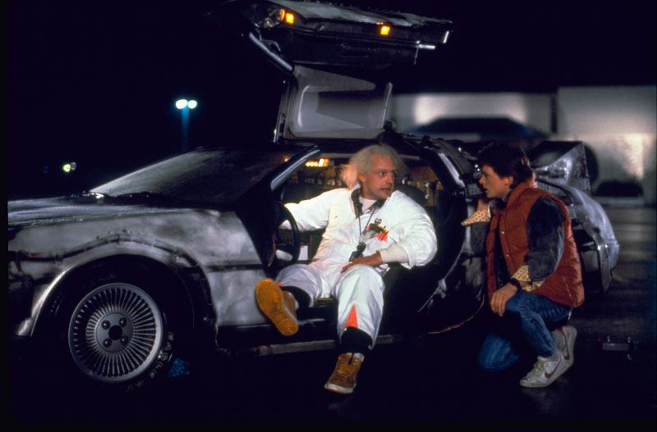
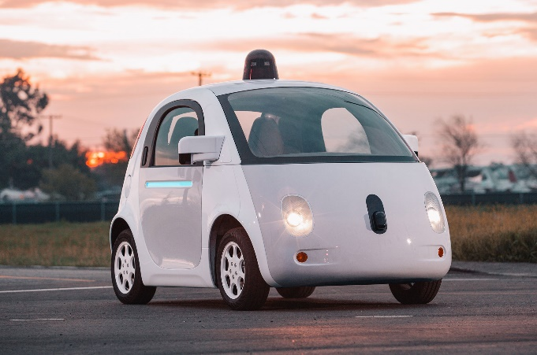
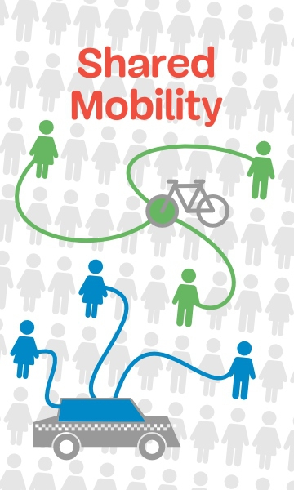

Why now?

Slide 11
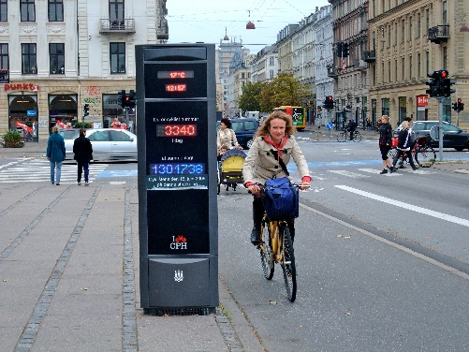
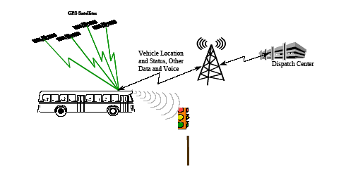
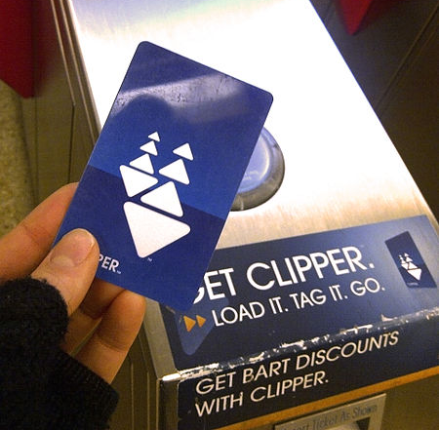
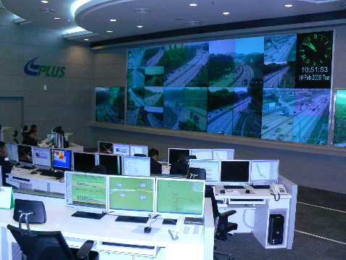
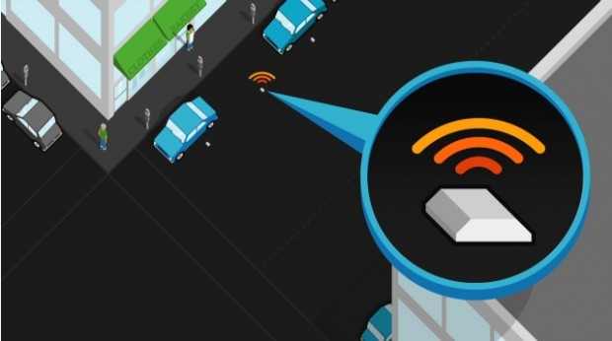
Increasingly, relevant and detailed data are being continuously collected, providing an opportunity to measure the changes that occur in the transport system.
Image from: wikipedia.com
Image from: appliedcomm.com
Image from: commons.wikimedia.org
Image from: commons.wikimedia.org
Image from: sfpark.org

Slide 12
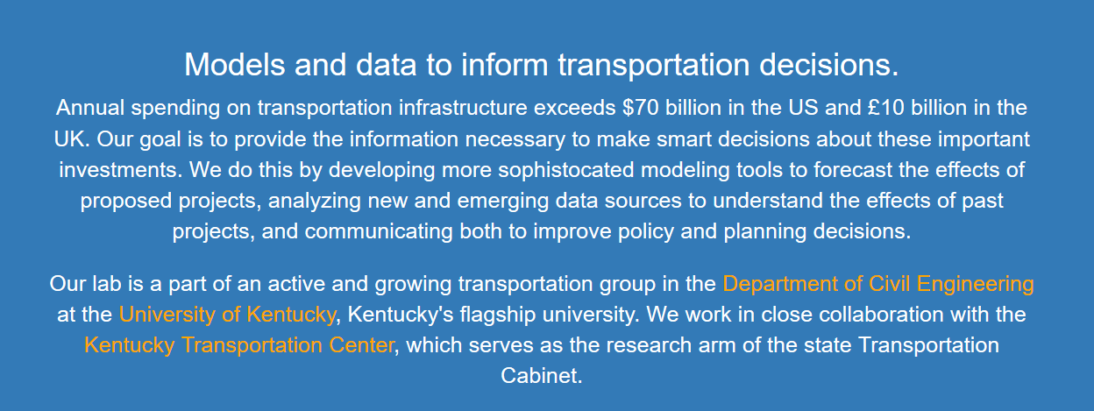

What I do…
What about you?

Slide 13

A note…
I’ve just given you a bunch of hype…
…can you separate the hype from the reality?

Slide 14
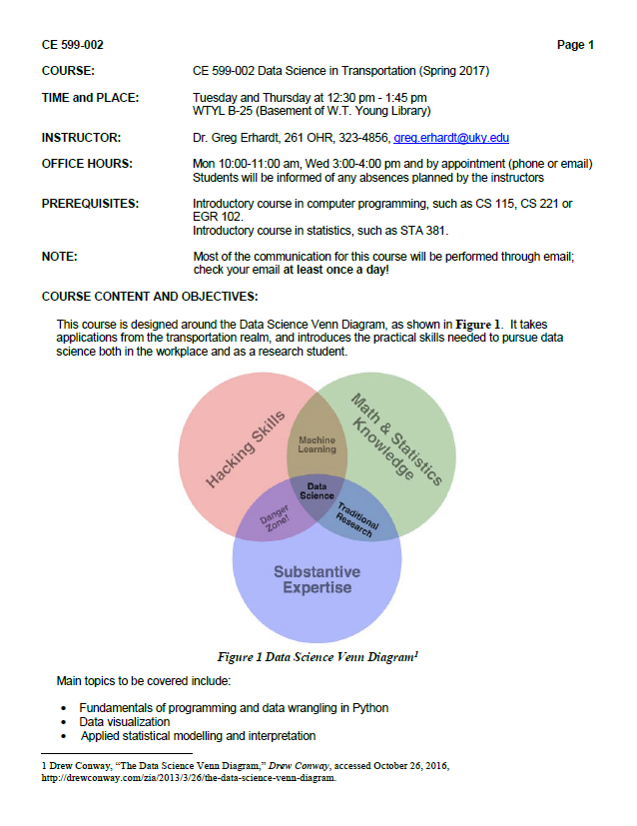
Syllabus & Expectations

Slide 15
Sources of Help
This is a “figure it out” class, not a “sit and listen” class!
Use these resources:
Class time
Text books, Libraries, Librarians
Dr. Google
Peers
Me
We won’t cover everything, but I hope you will start to learn how to “figure it out”

Slide 16
Let’s get started!
Go to:
https://github.com/uky-transport-data-science/ce599-s17
Download a zip file, and unzip it on your computer.
Poke around and see what’s in there.
Important!
The hard drives on these computers are wiped clean when you log off!

Slide 17
Let’s get started!
Go to:
https://github.com/uky-transport-data-science/ce599-s17
Download a zip file, and unzip it on your computer.
Poke around and see what’s in there.
Important!
The hard drives on these computers are wiped clean when you log off!

Slide 18
Let’s get started!
Open a command prompt
Shift + Right Click, or cmd from windows
5. From the class directory, type:
jupyter notebook
Open:
Introduction-to-jupyter-notebooks-and-python.ipynb

Slide 19
Software Installs
Notepad++
https://notepad-plus-plus.org/
Anaconda python distribution for python 3.5
https://www.continuum.io/
Github Desktop
https://desktop.github.com/
NoMachine (if working remotely)
https://www.nomachine.com/
MarkdownPad 2 (worry about this later)
https://www.markdownpad.com/
QGIS (worry about this later)
http://www.qgis.org/en/site/

